Slide 1
Unmet Need and Modifiable and Non-modifiable Risk Factors for Cardiovascular Disease
© 2016 Amgen Inc. All rights reserved. Not for Reproduction. USA-145-038822

Slide 2
Cardiovascular Disease in the US
Cardiovascular (CV) Disease¹
Leading Causes of Death in the US²
> 800,000 US deaths per year from heart disease, stroke, and other CV diseases
1 in 3 deaths in the US
~2,200 deaths per day – One death every 40 seconds
Cardiovascular diseases claim more lives than all forms of cancer and CLRD combined
CLRD = Chronic lower respiratory disease.
1. Mozaffarian D, et al. Circulation. 2016;133(4):e38-360. 2. National Center for Health Statistics. Deaths and Mortality. CDC FastStats. http://www.cdc.gov/nchs/fastats/deaths.htm. Accessed October 7, 2016.

Slide 3
US Prevalence and Impact of MyocardiaI Infarction and Stroke¹
MyocardiaI Infarction (MI)
~750,000 MIs in the US in 2013†‡
550,000 first heart attack (primary)
200,000 in people who have already had a first heart attack (secondary)
~370,000 US coronary disease deaths in 2013§
Prevalence of MI in the US* 7.6 million adults (≥20 years old)
Stroke
~795,000 strokes (all types) per year in the US‡**
1 in 20 US deaths in 2013
1 death every ~4 minutes
129,000 deaths/year
#5 cause of death in the US in 2013
Prevalence of stroke (all types) in the US* 6.6 million adults (≥20 years old)
* Based on NHANES survey data from subjects ≥ 20 years of age interviewed in 2009-2010 (N = 6,218) and 2011-2012 (N = 5,560).² † Mortality based on Centers for Disease Control and Prevention/National Center for Health Statistics, 2013 Mortality Multiple Cause-of-Death–United States. ‡ Includes new and recurrent events. § Incidence based on Atherosclerosis Risk in Communities study (2005–2012), National Heart, Lung, and Blood Institute. ** Incidence based on Greater Cincinnati/Northern Kentucky Stroke Study/National Institutes of Neurological Disorders and Stroke data for 1999 provided on August 1, 2007. US estimates compiled by NHLBI. Data include children.
1. Mozaffarian D, et al. Circulation. 2015;133(4):e38-360. 2. CDC. NHANES response rates and population totals.
https://www.cdc.gov/nchs/nhanes/response_rates_CPS.htm. Accessed October 18, 2016.

Slide 4
CVD Prevalence Increases with Age
* The sample size of subjects ≥ 20 years of age for NHANES 2009-2012, based on the total number of subjects ages ≥ 20 years of age interviewed for the NHANES 2009-2010 (N = 6,218 subjects) and NHANES 2011-2012 (N= 5,560 subjects) data reports.²
Source: NCHS and NHLBI. These data include CHD, HF, stroke, and hypertension. Adapted from American Heart Association
CHD = coronary heart disease; CVD = cardiovascular disease; HF = heart failure; NHANES = National Health and Nutrition Examination Survey.
1. Mozaffarian D, et al. Circulation. 2015;133(4):e38-360. 2. CDC. NHANES response rates and population totals.
https://www.cdc.gov/nchs/nhanes/response_rates_CPS.htm. Accessed October 18, 2016.

Slide 5
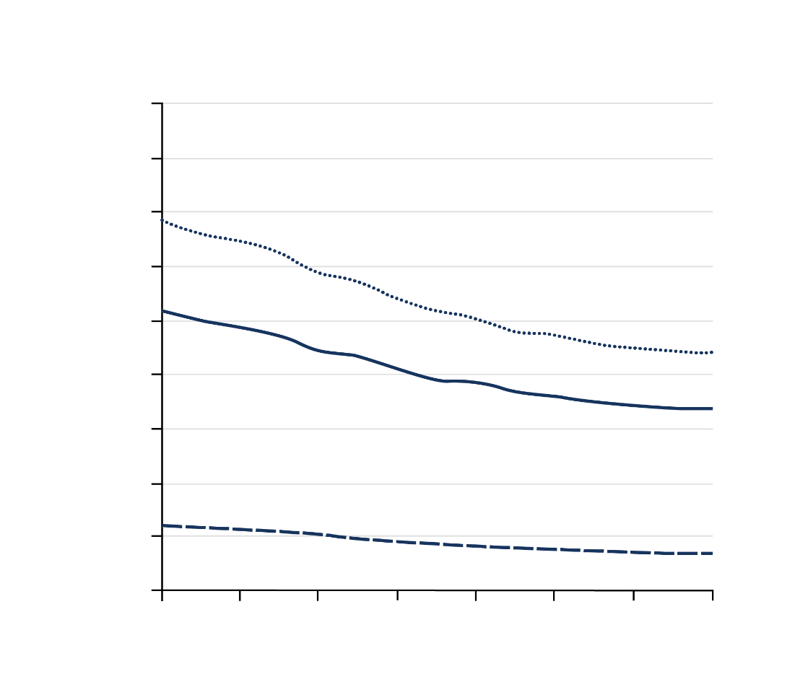

Recently, Declines in Heart Disease and CVD Mortality Have Slowed
Age-Adjusted Mortality Rates in US, 2000-2014¹
Annual Rates of Change
2000-2011; 2011-2014¹
450
Heart disease
400
Stroke
2000 - 2011 US Population (in 100 Millions):
2.8 - 3.1
350
All CVD
300
250
2011 - 2014 US Population (in 100 Millions):
3.1 - 3.2
Rate per 100,000 Person-years
Rate of Decline (%)
200
150
100
50
0
2000
2002
2004
2006
2008
2010
2012
2014
Year
US Population
(in 100 Millions): 2.8 2.9 2.9 3.0 3.0 3.1 3.1 3.2
2015 may be the first year that the CV death rate did NOT decline¹
1. Sidney S, et al. JAMA Cardiol. 2016;1(5):594-599.

Slide 6
Multiple Modifiable and Non-modifiable Factors May Contribute to Cardiovascular Risk
Lipid Disorders¹ (LDL-C↑, HDL-C↓, TG↑, Lp(a)↑)
Hypertension²
Physical Inactivity and Diet²
Type 2 Diabetes, Metabolic Syndrome²
Increased Cardiovascular Risk
Smoking²
Obesity²
History of CV Event⁶
Genetics³ (e.g., HeFH, HoFH)
Age, Race, Sex^{4,5}
Modifiable factors
Non-modifiable factors
CV = cardiovascular; HeFH = Heterozygous Familial Hypercholesterolemia; HDL = high density lipoproteins; HoFH = Homozygous Familial Hypercholesterolemia; LDL = low-density lipoproteins; Lp(a) = lipoprotein(a); TG = triglycerides.
1. Keenan TE, et al. Curr Cardiol Rep. 2013;(9):396. 2. Mendis S, et al. World Health Organization. 2011. 3. Sharifi M, et al. Heart. 2016;102(13):1003-1008. 4. Jellinger PS, et al. Endocr Pract. 2012;18(suppl 1):1-78. 5. Roger VL, et al. Circulation. 2012;125:e2-e220. 6. Stone NJ, et al. J Am Coll Cardiol. 2014;63:2889-2934.

Slide 7
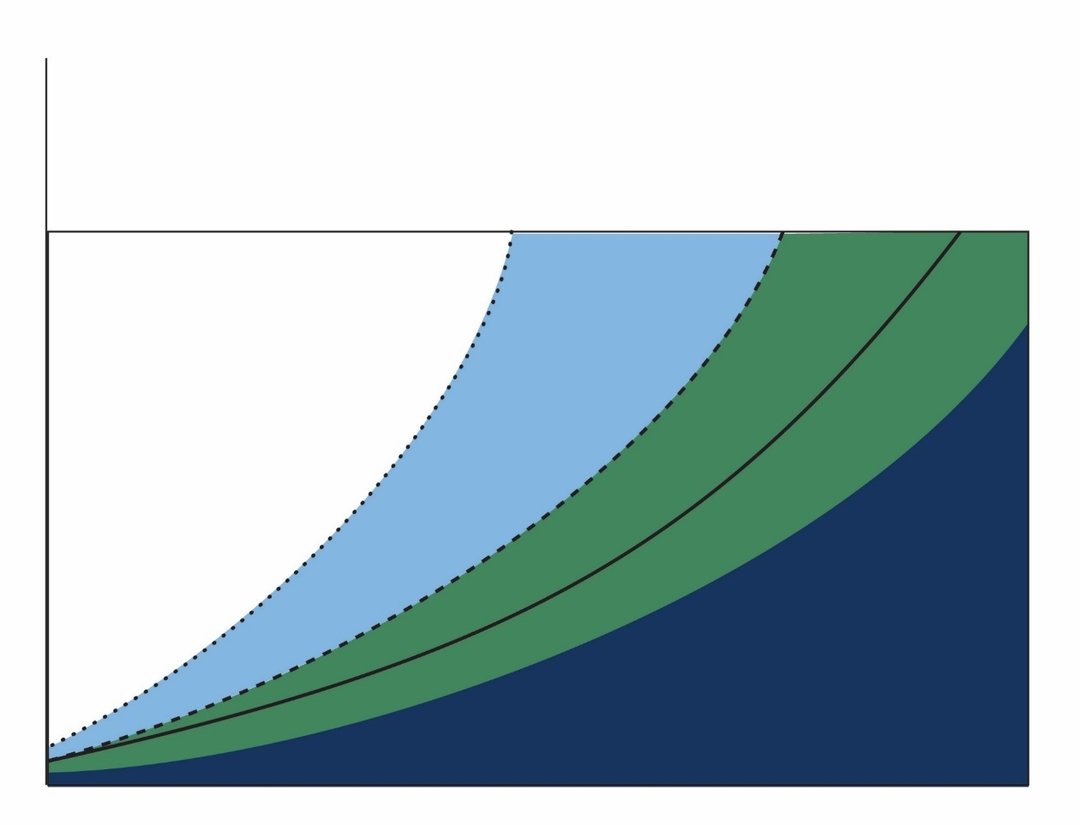
Not All CVD Risk Is Modifiable
Theoretical Disease Trajectories in Coronary Heart Disease Prevention¹
Postponement of coronary event
Gain in event free years
Plaque rupture
Statin
Statins + other therapies
Clinical event horizon
Statin modifiable risk
Probability of a clinical event
without prevention
with first-line statins
Statins + other therapies
with optimal risk factors
Primordial prevention of atherogenesis
Residual modifiable risk
Asymptomatic phase
Total modifiable risk
Optimal risk factor status
Non-modifiable risk age, sex, genetics
Increasing Age
”Other therapies” refers to any treatment or lifestyle modification that could further reduce residual risk. CVD = cardiovascular disease.
1. Adapted from Packard CJ, et al. Vascul Pharmacol. 2015;71:37-39.

Slide 8
Status of CV Health in the US Stratified by Modifiable Risk Factors and Age
Age Standardized Prevalence of Poor, Intermediate, and Ideal Cardiovascular Health¹ US Adults ≥ 20 Years of Age (NHANES 2011-2012, n = 5,560 interviewed²)
Current
Smoking
Physical
Activity
Healthy
Diet Score
Total
Cholesterol
Blood
Pressure
Fasting
Glucose
BMI
1.3
1.8
19.6
26.7
24.2
34.6
37.1
35.1
49.3
48.7
61.1
57.2
74.5
82.1
8.6
67.4
64.6
35.7
55.0
32.3
13.4
58.1
54.3
50.0
2.4
37.7
50.0
29.9
30.8
1.5
33.0
37.3
30.9
35.9
25.3
23.1
16.3
17.7
6.9
14.9
9.0
4.6
20-49
50
20-49
50
20-49
50
20-49
50
20-49
50
20-49
50
20-49
50
Many adults in the US have less than ideal status on various modifiable CV risk factors¹
Ideal cardiovascular health is defined by the absence of clinically manifest CVD together with the simultaneous presence of optimal levels of all 7 metrics, including not smoking and having a healthy diet pattern, sufficient PA, normal body weight, and normal levels of TC, BP, and fasting blood glucose in the absence of drug treatment. In the above graphic, each of the seven metrics is defined as ideal, intermediate, or poor based on criteria generated for each category. See reference for definitions of each level for all 7 metrics.¹
BMI = body mass index; BP = blood pressure; CV = cardiovascular; CV = cardiovascular disease; NHANES = National Health and Nutrition Examination Survey; PA = physical activity; TC = total cholesterol.
1. Mozaffarian D, et al. Circulation. 2015;133(4):e38-360. 2. CDC. NHANES response rates and population totals.
https://www.cdc.gov/nchs/nhanes/response_rates_CPS.htm. Accessed October 18, 2016.

Slide 9
Modifiable CV Risk Factors: Prevalence of Smoking
6% of adolescents (aged 12 to 17) are current smokers
Among adults, 19% of men and 15% of women are smokers
In 2013, there were approximately 5,700 new cigarette smokers every day
*All percentages are age-adjusted.
†The sample size of subjects ≥ 18 years of age for National Health Interview Survey years 2012-2014 is based on is based on the total number of subjects ages ≥ 18 years of age interviewed for the 2012 NHIS (34,525 subjects), the 2013 NHIS (34,557 subjects) and the 2014 NHIS (36,697 subjects).^{2,3}
AIAN = American Indian and Alaska Native; NH = non-Hispanic; NHIS = National Health Interview Survey; NHOPI = Native Hawaiian and other Pacific Islanders.
1. Mozaffarian D, et al. Circulation. 2015;133(4):e38-360. 2. CDC. National Center for Health Statistics.
Health, United States, 2014: With Special Feature on Adults Aged 55–64. Hyattsville, MD. 2015. 3. CDC. National Center for Health Statistics. Survey Description, National Health Interview Survey, 2014. Hyattsville, Maryland. 2015.

Slide 10
Modifiable CV Risk Factors: Prevalence of Obesity*
Data derived from Health, United States, 2014.
* Obese is defined as BMI ≥30.0 kg/m².
† The sample size of subjects is based on the number of subjects ages years interviewed for the NHANES during these times. Total number of interviewed subjects per period are as follows:1988-1994 (N = 33,994), 1999-2000 (N = 9,965), 2001-2002 (N = 11,039), 2003-2004 (N = 10,122), 2005-2006 (N = 10,348), 2007-2008 (N = 10,149), 2009-20010 (N = 10,537), and 2011-2012 (N =9,756).²
1. Mozaffarian D, et al. Circulation. 2015;133(4):e38-360. 2. CDC. NHANES response rates and population totals.
https://www.cdc.gov/nchs/nhanes/response_rates_CPS.htm. Accessed October 18, 2016.

Slide 11
Modifiable CV Risk Factors: Prevalence of High Blood Pressure¹
Approximately 80 million (33%) US adults have high blood pressure
About 77% are using antihypertensive medication
46% of those with hypertension remain uncontrolled*
Hypertension is projected to increase by 8% from 2013 to 2030
* Controlled hypertension is defined as having systolic blood pressure below 140 mm Hg and diastolic blood pressure below 90 mm Hg among those with hypertension. Uncontrolled hypertension is defined as having values above these levels.
† The sample size of subjects ≥ 20 years of age for NHANES 2009-2012 is based on the total number of subjects ages ≥ 20 years of age interviewed for the NHANES 2009-2010 (N = 6,218 subjects) and NHANES 2011-2012 (N= 5,560 subjects) data reports.²
High blood pressure is defined as SBP ≥140 mm Hg or DBP ≥90 mmHg, or taking antihypertensive medication, or being told twice by a physician or other professional that one has high blood pressure. Source: NCHS and NHLBI.
DBP = diastolic blood pressure; SBP = systolic blood pressure; NHANES = National Health and Nutrition Examination Survey.
1. Mozaffarian D, et al. Circulation. 2015;133(4):e38-360. 2. CDC. NHANES response rates and population totals.
https://www.cdc.gov/nchs/nhanes/response_rates_CPS.htm. Accessed October 18, 2016.

Slide 12
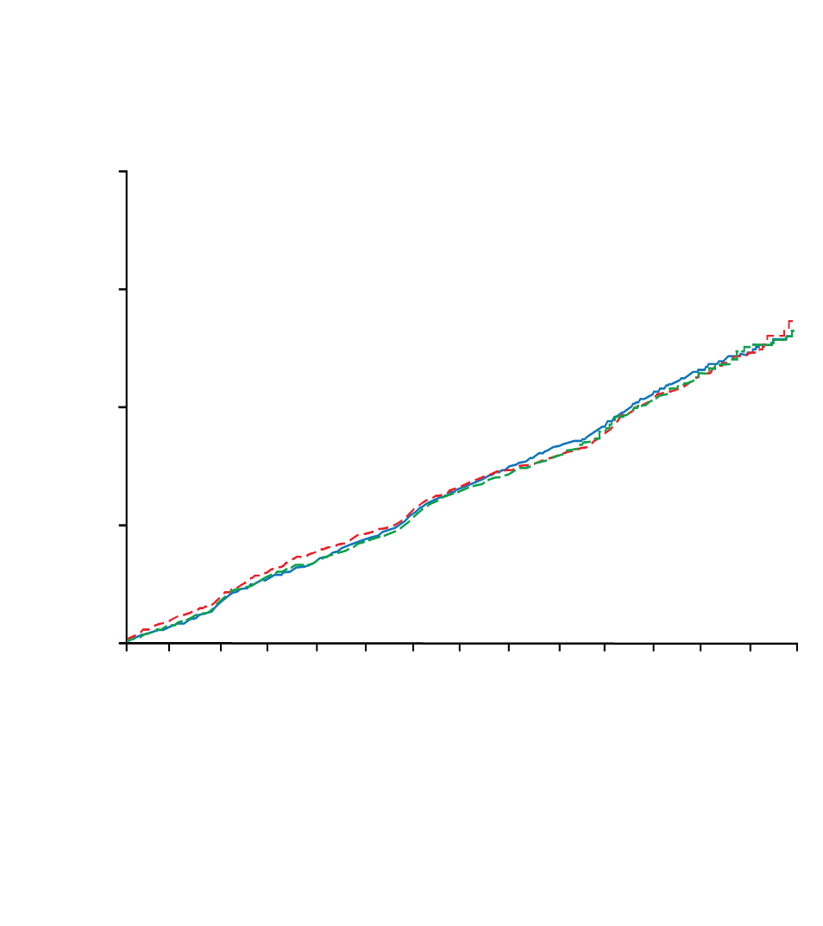

CV Outcomes and Modifiable Risk Factors: Blood Pressure
Antihypertensive and Lipid-lowering Treatment to Prevent Heart Attack Trial (ALLHAT)¹
Blood Pressure by Treatment at Baseline and Annual Visits
 |  | Baseline | Year 1 | Year 2 | Year 3 | Year 4 | Year 5
Chlorthalidone | No of Participants | 15,255 | 12,862 | 11,740 | 10,698 | 9,379 | 5,301
 | SBP Mean (SD), mm Hg | 146.2 (15.7) | 136.9 (15.8) | 135.9 (15.9) | 134.8 (15.4) | 133.9 (15.7) | 133.9 (15.2)
 | DBP Mean (SD), mm Hg | 84.0 (10.1) | 79.3 (9.9) | 78.3 (9.6) | 77.2 (9.5) | 76.5 (9.7) | 75.4 (9.8)
 | Achieved BP Goal* No (%) | 4,149 (27.2) | 7,434 (57.8) | 7,161 (61.0) | 6,836 (63.9) | 6,293 (67.1) | 3,615 (68.2)
Amlodipine | No of Participants | 9,048 | 7,609 | 6,883 | 6,381 | 5,637 | 3,195
 | SBP Mean (SD), mm Hg | 146.2 (15.7) | 138.5 (14.9) | 137.1 (15.0) | 135.6 (15.2) | 134.8 (15.0) | 134.7 (14.9)
 | DBP Mean (SD), mm Hg | 83.9 (10.2) | 78.7 (9.5) | 77.7 (9.6) | 76.4 (9.6) | 75.7 (9.6) | 74.6 (9.9)
 | Achieved BP Goal* No (%) | 2,497 (27.6) | 4,200 (55.2) | 3,951 (57.4) | 4,046 (63.4) | 3,709 (65.8) | 2,118 (66.3)
Lisinopril | No of Participants | 9,054 | 7,521 | 6,700 | 6,076 | 5,325 | 2,963
 | SBP Mean (SD), mm Hg | 146.4 (15.7) | 140.0 (18.5) | 138.4 (17.9) | 136.7 (17.3) | 135.5 (17.2) | 135.9 (17.9)
 | DBP Mean (SD), mm Hg | 84.1 (10.0) | 79.9 (10.5) | 78.6 (10.3) | 77.3 (10.3) | 76.6 (10.4) | 75.4 (10.7)
 | Achieved BP Goal* No (%) | 2,381 (26.3) | 3,806 (50.6) | 3,625 (54.1) | 3,597 (59.2) | 3,360 (63.1) | 1,813 (61.2)
20
CV Outcome Event Rates by Blood Pressure Treatment Groups
15
Cumulative Primary Outcome† Event Rate (%)
10
5
0
1
2
3
4
5
6
7
Year
Chlorthalidone
Amlodipine
Lisinopril
No. at Risk
15255
14477
13820
13102
11362
6340
2956
209
Chlorthalidone
9048
8576
8218
7843
6824
3870
1878
215
Amlodipine
9054
8535
8123
7711
6662
3832
1770
195
Lisinopril
Despite lowering of blood pressure, CV events occurred across the study population, indicating that CV risk remained¹
*Blood Pressure Goal <140/90 mm Hg.
†Primary outcome = fatal coronary heart disease of nonfatal myocardial infarction.
BP = blood pressure; CV = cardiovascular; DBP = diastolic blood pressure; SBP = systolic blood pressure.
1. ALLHAT. JAMA. 2002;288(23):2981-2997.

Slide 13
Prevalence of Diagnosed Diabetes Has Increased Over Time
Age-Adjusted Prevalence of Diagnosed Diabetes Among US Adults
1994
2014
2005
Missing Data
< 4.5%
4.5 – 5.9%
6.0 – 7.4%
7.5 – 8.9%
≥ 9.0%
1. CDC. Maps of Trends in Diagnosed Diabetes and Obesity. http://www.cdc.gov/diabetes/statistics/slides/maps_diabetesobesity_trends.pdf. Accessed October 7, 2016.

Slide 14
Modifiable CV Risk Factors: Prevalence of Elevated Blood Lipids
(N = 5,935*)
(N = 6,218*)
(N = 5,560*)
Elevated total cholesterol is highly prevalent, regardless of race or sex¹
* Total number of subjects ≥ 20 years of age that were interviewed. Source: NCHS and NHLBI. NH indicates non-Hispanic; NHANES = National Health and Nutrition Examination Survey.
1. Mozaffarian D, et al. Circulation. 2015;133(4):e38-360. 2. CDC. NHANES response rates and population totals.
https://www.cdc.gov/nchs/nhanes/response_rates_CPS.htm. Accessed October 18, 2016.

Slide 15
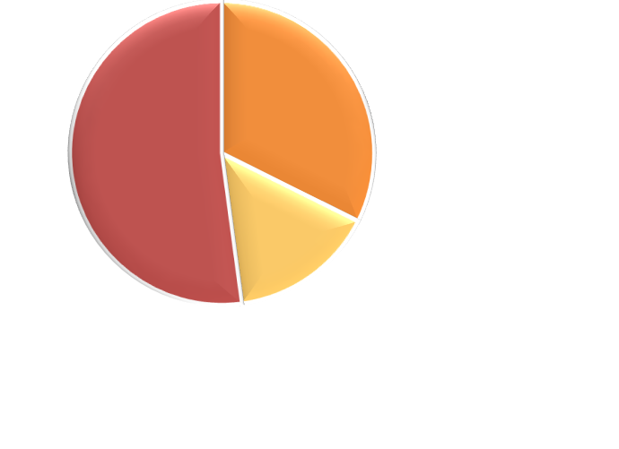
Approximately 48% of American Adults With High LDL-C Receive Treatment
Prevalence, Treatment, and Control of LDL-C Based on NHANES 2005-2008^{1*}
US Adult Population
US Adults With High LDL-C
23 million were treated and at goal‡
37 million were untreated
11 million were treated
but not at goal‡
*Extrapolated from data from 3,996 adults with high LDL-C aged ≥ 20 years in the NHANES 2005-2008.
†High LDL-C defined as > 160 mg/dL for low-risk adults; > 130 mg/dL for moderate-risk adults; and > 100 mg/dL for high-risk adults or the use of cholesterol-lowering medication.
‡Adult Treatment Panel (ATP) III LDL-C goals: < 160 mg/dL for low-risk adults; < 130 mg/dL for moderate-risk adults; and < 100 mg/dL for high-risk adults.
LDL-C = low-density lipoprotein cholesterol; NHANES = National Health and Nutrition Examination Survey.
1. Kuklina EV, et al. MMWR Morb Mortal Wkly Rep. 2011;60(4):109-114.

Slide 16
Residual CV Risk Remains Despite Treatment for LDL-C
CV Event Rates in Large Prospective Treatment Studies¹
Secondary Prevention
Primary Prevention
Patients That Suffered Major CV Events (%)
Statin Trial Name
4S
4,444
CARE
4,159
LIPID
9,014
HPS
20,536
PROSPER
5,804
ASPEN
2,410
TNT
10,001
ASCOT
-LLA
10,305
ALLHAT
10,355
WOSCOPS
6,595
AFCAPS/TexCAPS
6,605
CARDS
2,838
N
1. Sampson UK, et al. Curr Atheroscler Rep. 2012;14(1):1-10.

Slide 17
Residual CV Risk Remains in Those Receiving Treatment with High-Intensity Statins
Incidence of Major CVD Events and Levels of LDL-C in Patients Receiving Standard or High-Dose Statin Therapy
PROVE IT-TIMI 22¹
IDEAL²
TNT³
N 4,162 8,888 10,001
Patient Population ACS History of MI Stable CHD
LDL-C,* mg/dL 95 62 104 81 101 77
* Mean or median LDL-C after treatment.
ACS = acute coronary syndrome; MI = Myocardia Infarction
1. Cannon CP, et al. N Engl J Med. 2004;350:1495-1504. 2. Pederson TR, et al. JAMA. 2005;294:2437-2445. 3. LaRosa JC, et al. N Engl Med. 2005;352:1425-1435.

Slide 18
Summary
Recent declines in cardiovascular (CV) mortality in the US have slowed¹
Multiple factors contribute to residual cardiovascular risk, some of which are modifiable²
Major modifiable risk factors include smoking, high blood pressure, obesity, diet, diabetes, and blood lipids. There is additional interplay among these risk factors³⁻⁴
A substantial number of Americans continue to smoke and the prevalence of obesity continues to increase over time for all age groups⁵
Despite reduction in CV outcomes with blood pressure lowering therapies, residual risk still exists⁶
Lipid-lowering therapies, namely statins, can reduce CV events, though many patients continue to have further CV events and residual risk can remain despite high-intensity statin treatment⁷⁻¹¹
Despite current treatment, residual CV risk may remain in patients who continue to have CV events⁷⁻¹¹
1. Sidney S, et al. JAMA Cardiol. 2016;1(5):594-599. 2. Mora S, et al. Circulation. 2012;125:1979-1987. 3. Keenan TE, et al. Curr Cardiol Rep. 2013;(9):396. 4. Mendis S, et al. World Health Organization. 2011. 5. Mozaffarian D, et al. Circulation. 2015;133(4):e38-360. 6. ALLHAT. JAMA. 2002;288(23):2981-2997. 7. Sampson UK, et al. Curr Atheroscler Rep. 2012;14:1-10. 8. Cannon CP, et al. N Engl J Med. 2004;350:1495-1504. 9. Pederson TR, et al. JAMA. 2005;294:2437-2445. 10. LaRosa JC, et al. N Engl Med. 2005;352:1425-1435. 11. Cannon CP, et al. N Engl J Med. 2015; 372:2387-2397.

